Slide 1


GHOST
IN THE HIRING MACHINE
How to spot fake personas before they're on your payroll
RISHI
MICHAEL
Security Researcher
Security Researcher
Notes:
Rishi

Slide 2
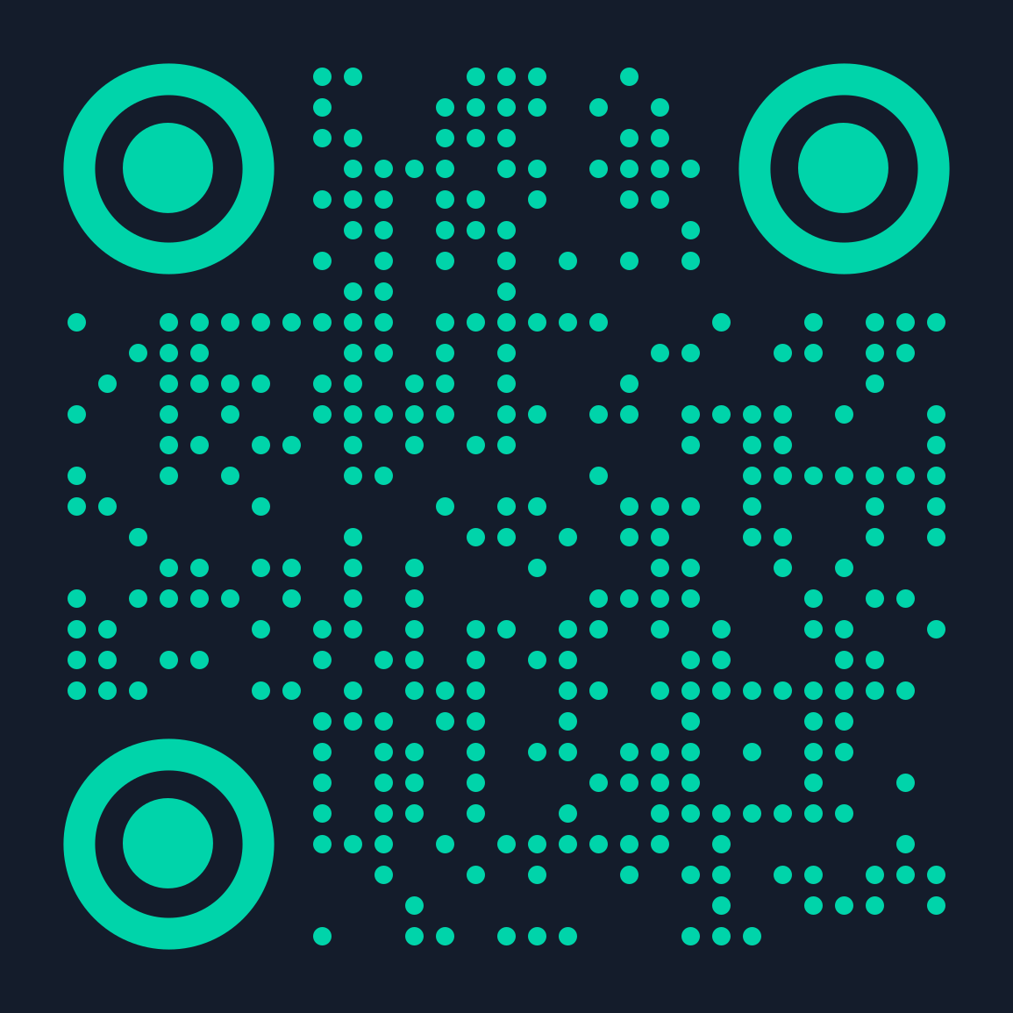
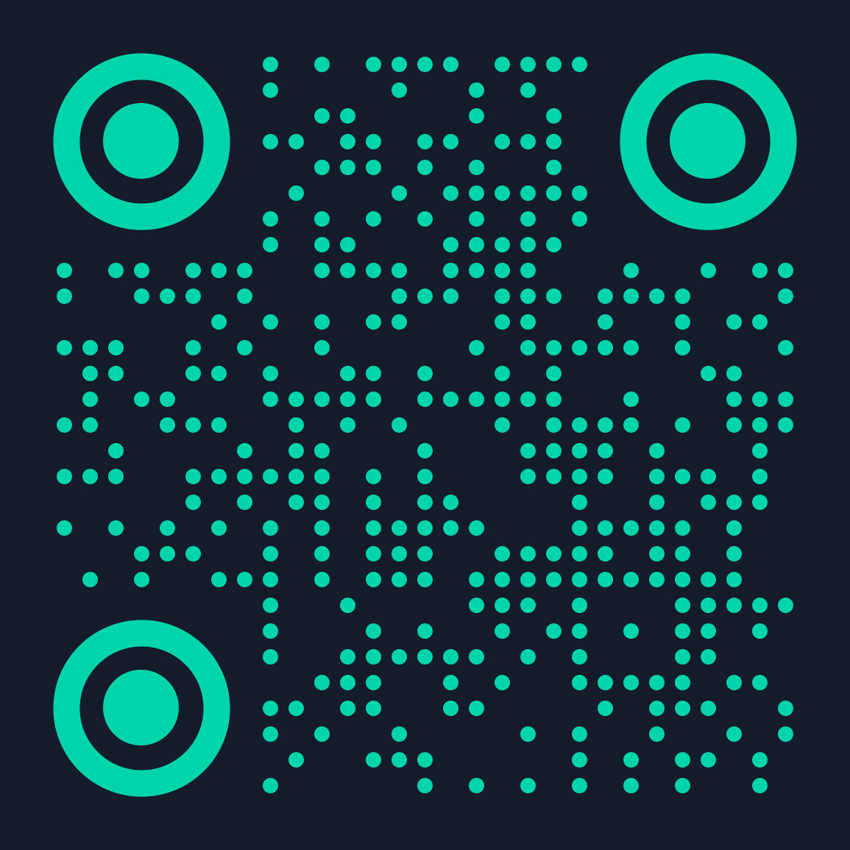

Who are we?
SPEAKER
SPEAKER
RISHI
MICHAEL
Security Researcher
Security Researcher
London, UK
Germany
Vulnerability research, detection engineering, attack surface management
Threat intelligence & OSINT
Leadership Team - UK OSINT Community
AI Security, AppSec, OffSec and OSINT
CISSP, OSCP, GCPN
Organization Team - BSides Luxembourg
2
Notes:
Both

Slide 3


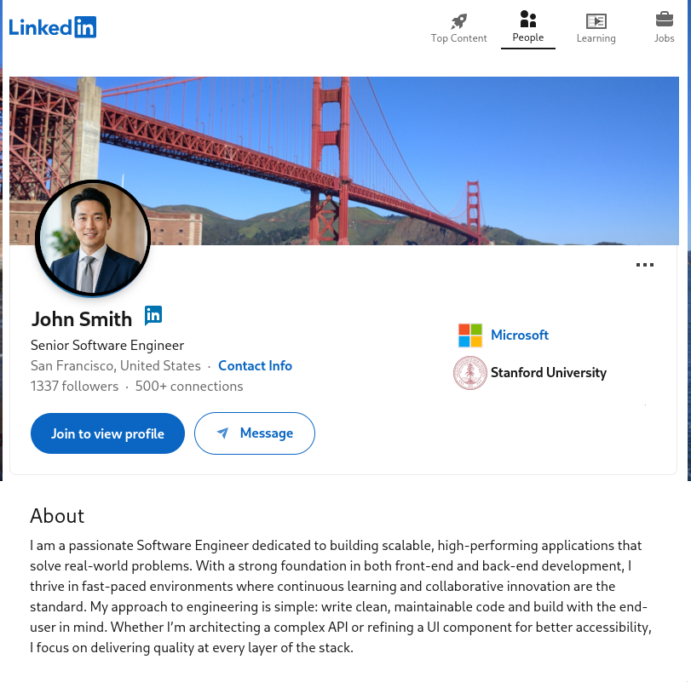
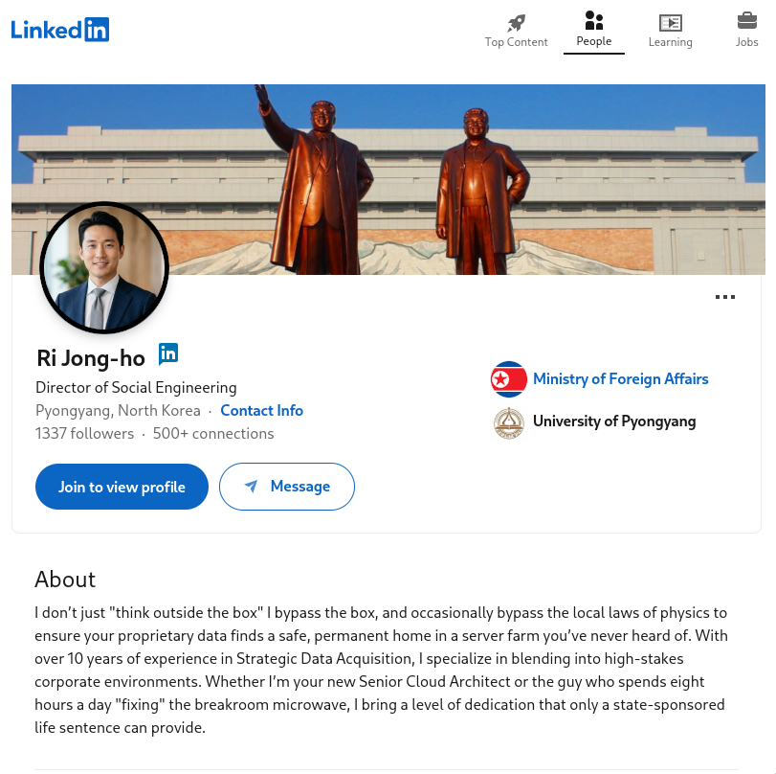
Why does this matter?
THE PERFECT HIRE…
looks legit
…FROM PYONGYANG
FLAGGED
3
Notes:
Michael

Slide 4
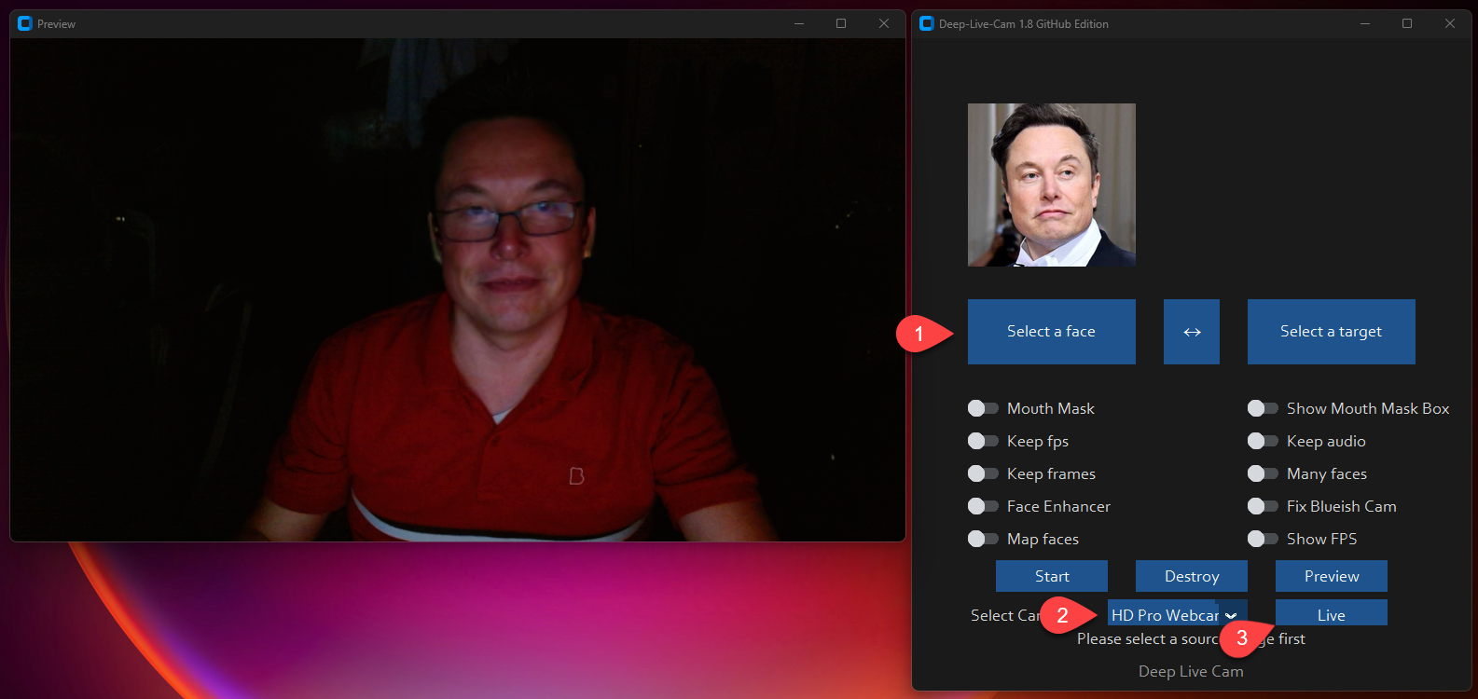


The tools have caught up
Deep-Live-Cam
github.com/hacksider/deep-live-cam
Open-source real-time deepfake. Swaps any face onto a live video call.
Cluely
cluely.com
AI meeting assistant that feeds real-time answers - "undetectable" by design.
4
Notes:
Michael

Slide 5



KnowBe4: When a security firm gets fooled
JULY 2024
Application
4 Video Interviews
Mac Delivered
9:55 PM EST
Stolen US identity + AI-enhanced stock photo
Passed all checks and references
Shipped to a laptop-farm location
Malware deployed - caught in 25 minutes
WHAT OSINT COULD HAVE CAUGHT
Stock photo flagged by reverse image search
Shipping address didn't match residence
No genuine social media footprint
If it can happen to a cybersecurity company, it can happen to anyone.
5
Notes:
Michael

Slide 6
The motivations behind the mask
1. FINANCIAL GENERATION - THE VOLUME ENGINE
2. ESPIONAGE & STRATEGIC INTELLIGENCE
3. SABOTAGE & DISRUPTION - LESS FREQUENT, HIGH IMPACT
High-margin wage extraction
Credential & network mapping
Reputational/legal exposure
$60K–$300K+ per contract, often multiple simultaneous roles
VPNs, cloud admin, CI/CD access as persistent footholds for future intrusions
exposing sanctioned-regime funding once uncovered
Supply chain compromise
Infiltration pivoting
malicious packages/backdoors in open-source or enterprise libraries
lateral attacks on partner orgs, financial institutions, government contractors
Critical infrastructure reconnaissance
mapping utility, telecom, or defense-adjacent networks for future access
Sanctions evasion tradecraft transfer
learning Western compliance/KYC blind spots to refine future infiltration
The pragmatic rule: for 90%+ of operatives, money is the day-to-day KPI. Espionage and sabotage happen opportunistically or via direct tasking from embedded handlers.
6
Notes:
Michael
So why bothering with this hiring scheme to get into companies?
Most of the time it’s financial motivation
These jobs pay a good salary and if you can do multiple at the same time you have good income
Especially if you compare the salary difference between north america and other countries
Once they’re inside the company, they can also gather intelligence
That includes harvesting credentials but also gathering information about the tech stack
This is especially interesting if it’s in the critical infrastructure sector
and of course they can create a backdoor for later operations
When these incidents hit the news, it usually damages the reputation
especially when the company is just being used as a proxy to get to another business

Slide 7
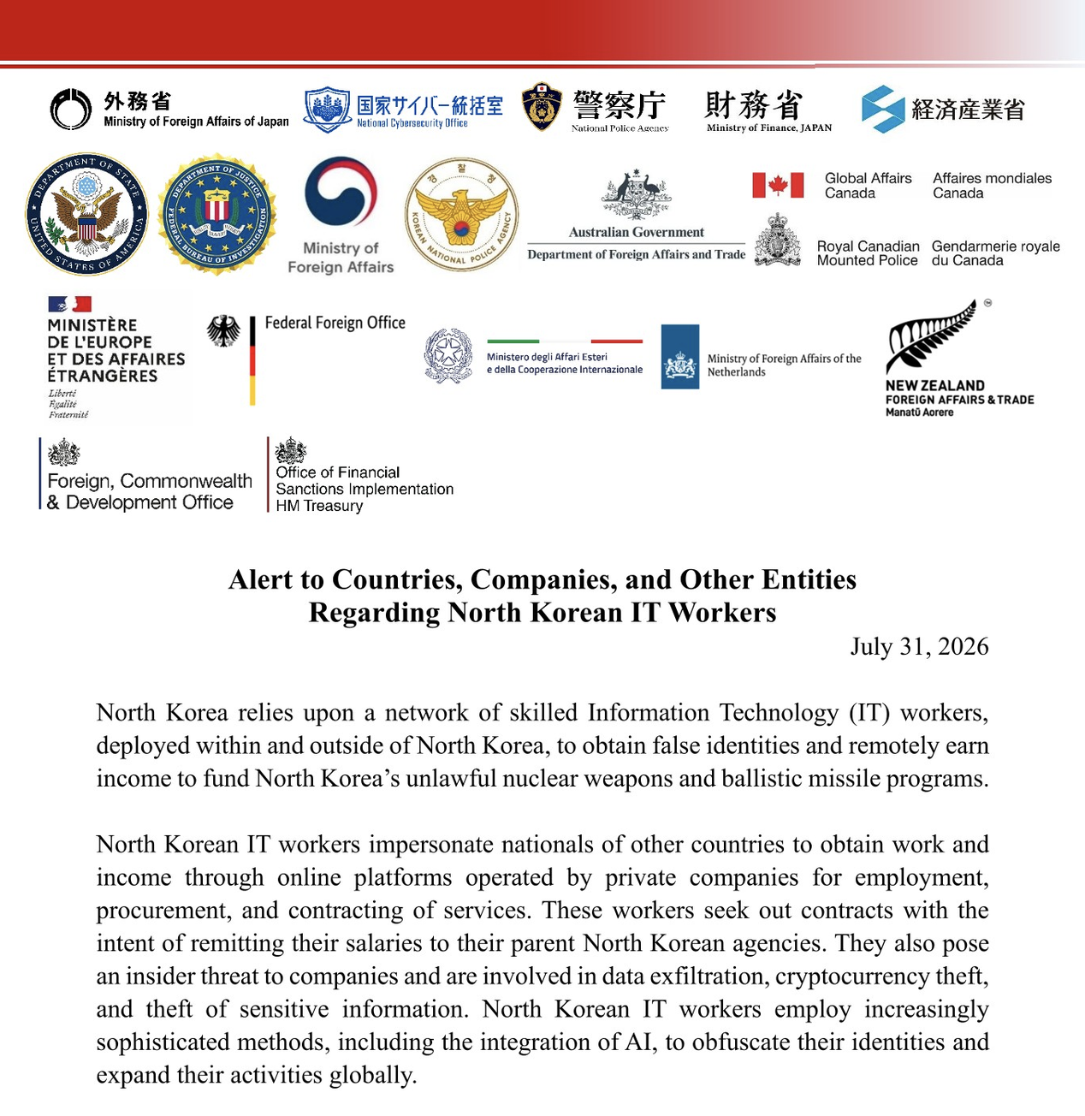
Canada is a target, not just an observer
THE STEPHEN MAURO CASE
1
In May 2025, a researcher found the professional seal of GTA architect Stephen Mauro on construction drawings.
2
The drawings came from a firm he'd never heard of.
3
He never signed it - the signature didn't even match his own.
The seal was real. The architect wasn't.
Part of a wider pattern: over $49M lost to job scams in Canada in a single year. Sources: CBC News - The Fifth Estate · Asia Pacific Foundation of Canada
Source: Global Affairs Canada, joint statement, July 31, 2026
7
Notes:
Michael
Several governments including the canadian government published an alert warning about the North Korean IT workers and rate them as a high risk
Okta Threat Intelligence analyzed 130 identities operated by the DPRK ITW targeting more than 5,000 distinct companies up until mid-2025
US based companies are top target (73%)
Canada was a little over 2% in this report - not the main target but it’s on the radar
Which is shown by the Stephen Mauro Case where an imposter, believed to be North Korean, forged the official seal of an Ontario architect
His stamp appeared on a blueprint for a "boutique studio" designed by a company called Global Creative Consultant Engineers (GCCE)
Mauro stated he had never heard of GCCE, had never seen the drawing before and did not stamp it.

Slide 8








The OSINT toolkit for identity verification
Reverse Image Search
Username Enumeration
Email Footprint
Breach Data
Google, TinEye, Yandex, PimEyes - detect stock & stolen photos
Sherlock, Maigret, WhatsMyName - trace across 400+ platforms
holehe, Epieos, Hunter.io - find linked accounts via resets
Have I Been Pwned - reveals registrations & security hygiene
Reset flows, no alert
Zero hits = generated
Age, not existence
No breaches = new
Phone OSINT
Public Records
Domain Analysis
Metadata Extraction
PhoneInfoga, HLR lookup - VoIP vs mobile, carrier, porting
Corporations Canada, Québec REQ, OSB, CanLII
WHOIS, historical DNS, reverse WHOIS - ownership patterns
ExifTool, FOCA - GPS coords, device info, author names
VoIP is the red flag
13 registries, no index
Author field on the PDF
Does it predate the CV?
Pro tip: cross-reference - no single tool gives the full picture.
Warning: username tools have ~30% false positives. Verify manually.
8
Notes:
Rishi

Slide 9







Canadian public records: your intelligence
Corporations Canada
Québec REQ
~235K CBCA corps · 13 registries
Person-name search since Jul 2024
Company-name search only
The only person-pivot
WHY THIS MATTERS
Brigitte Cleroux
Regulatory Colleges
Credential Checks
Fake nurse · 899 patients
Worked a year at BC Women's Hospital under a real nurse's name. She had never been to nursing school.
CPSO · BCCNM · CNO · law societies
No Clearinghouse - call the registrar
Free registers, per province
WES ECA C$264, foreign only
The name matched. The licence number didn't.
Pro tip:match the licence number to the person, not just the name.
OSB Insolvency
Courts & Records
Every bankruptcy · C$8 a search
CanLII free · OCPP (ON) · CSO (BC)
Billed even on a no-record
Criminal records never public
ALSO CHECK: OnLand / LTSA ~C$11 · CRA Charities · Canada Gazette · RCMP CCRTIS
9
Notes:
Corporations Canada
Corporations Canada is the federal company registry. It shows directors and, since 2024, who really controls the company. The catch: you can only search by company name, not by person.
Québec REQ
Québec is different. Since July 2024, you can search a person's name and see which companies they run or own. You can't do that federally.
Regulatory Colleges
Doctors, nurses and lawyers are licensed by province, and each college has a free online register. Check every province they say they've worked in.
Credential Checks
Canada has no central degree database like the US. You call the school's registrar, with the candidate's consent. Foreign degrees go through WES.
OSB Insolvency
Every bankruptcy since 1978 is here, at eight dollars a search. You pay even if nothing comes up, so get the name right first.
Courts & Records
CanLII is free, but it only shows cases with a written decision, so no result doesn't mean no case. Ontario and BC have their own court searches, though Ontario's new portal only covers Toronto for now. And while court files are public, criminal records aren't. For those, you need the person's consent.
Why this matters
Here's why this matters. Brigitte Cleroux worked as a nurse at BC Women's Hospital for a year and cared for 899 patients. She never finished nursing school, never had a licence, and already had at least 67 criminal convictions. How? She used a real nurse's name, so the name matched. She just said her licence number was still pending. Now the health authority checks both the name and the licence of every nurse it hires. The lesson: match the licence number to the person, not just the name.

Slide 10
GitHub commit forensics
WHAT TO HUNT FOR
SIGNAL
WHAT IT REVEALS
Buried commit identities
A commit accidentally authored under a different name or email than the one on the CV, maybe an old identity, a shared machine, or a simple slip-up.
Leaked config or paths
Scripts, configs, or backup paths can stamp a login, hostname, or file path that doesn't match the claimed identity.
Wrong-keyboard-layout typos
Commit messages typed on a non-US layout (e.g. y/z swaps, Cyrillic keys hit as QWERTY) come out garbled, but remapping the keys reveals the real text.
Timezone mismatches
Commit timestamps consistently offset from the timezone the candidate claims to work in.
Deleted files/commits
A file added and then quietly removed a few commits later is still fully recoverable from history.
Secret-scanning tools
Run gitleaks or trufflehog across the full history to catch hardcoded keys, tokens, or credentials committed and later removed.
GOAL:
A GitHub account on a resume can leak more than code. Commit history often tells a different story than the current file tree.
10
Notes:
Rishi

Slide 11
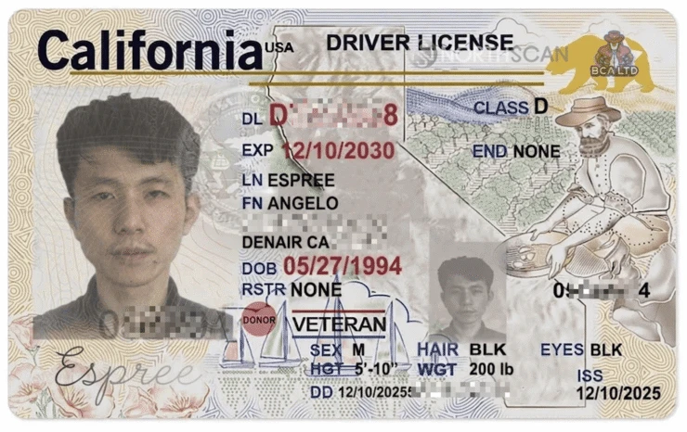
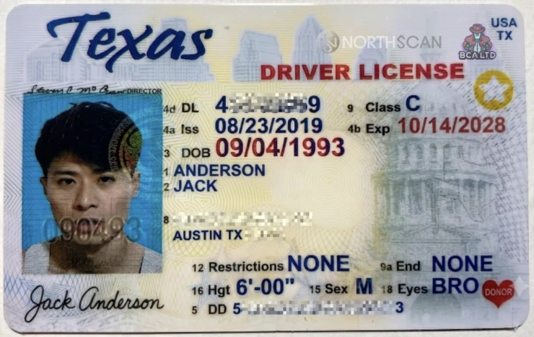
Metadata & hidden content
WHAT TO HUNT FOR
DOCUMENTS AREN'T THE ONLY THING WITH METADATA
SIGNAL
WHAT IT REVEALS
Author metadata mismatch
Document properties (Creator, Last saved by) show a different name - sometimes in a different script - than the one on the document.
Leftover address & employer fields
Custom document properties can carry a real address, employer, or employee ID from a template the operator never scrubbed.
File path & embedded comments
The original file path or a leftover Word comment can reveal a username or working folder tied to the real operator.
Invisible prompt-injection text
Hidden or white-on-white text can instruct an LLM-based applicant tracking system to advance the candidate automatically.
Address resolves to virtual office
The listed address matches a virtual office or registered-agent drop, not a residence.
Geolocation & AI-generation watermarks
EXIF GPS coordinates can place a photo far from the claimed location; content-credential (C2PA) tags or generator signatures can flag an AI-produced image.
GOAL:
Inspect the document file itself - its metadata and raw underlying content - for anything invisible when the file is simply opened and read.
IDs used in DPRK IT worker operations. Source: Mauro Eldritch & Heiner García - any.run - Lazarus Group IT Workers Investigation, Part Two
11
Notes:
Michael
Documents such as CVs, Cover Letters or photos contain Metadata which can reveal important information
We can check if the author field contains a different name or if there’s address left
It doesn’t proof that the person uses a false identity, but it can be an indicator for an investigation
Similar if the document contains a file path, it could contain a username or real name which we can use to do more enumeration
Here you can see two ids used by north koreans to infiltrate companies
It’s from the research of Mauro Eldritch & Heiner Garcia which I highly recommend to read
In one of these IDs they found a watermark of Gemini in the metadata

Slide 12




Verifying identity documents
PRADO
Check Document Numbers
consilium.europa.eu/prado
prado/check-document-numbers
Public Register of Authentic identity and travel Documents Online. Shows security features of ID cards, licences & passports.
PRADO's collection of external sources to validate document numbers against issuing registries.
Provincial Driving Licence Checks
Pan-Canadian Trust Framework
dlc.rus.mto.gov.on.ca
diacc.ca/pctf
Ontario's MTO lets you check if a licence number is valid or suspended (no personal details returned). Quebec's SAAQ offers a similar check through SAAQclic Entreprises.
DIACC's national standard for digital identity assurance. Adoption by provinces & private-sector providers is voluntary - Canada has no single unified ID database.
True validity: Contact law enforcement or the issuing authority.
12
Notes:
Michael
Ontario MTO
Check’s if a driving licence is suspended, cancelled or expired
Doesn’t return any personal information
Pan-Canadian Trust Framework
a non-profit coalition of public and private sector
they provide guidelines for secure id verification and list trusted partner that match their guidelines
https://diacc.ca/certification-program/trusted-list/

Slide 13
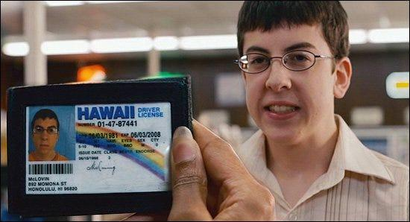
GTA Europe: fraudulent identities, real vehicles
1
An organised international group targeted vehicle-rental companies in 2024.
2
Fraudulent identities were used to rent the vehicles.
3
The vehicles were resold to unsuspecting buyers via online marketplaces.
© 2007 Columbia Pictures - Superbad, a Judd Apatow production
13
Notes:
Michael

Slide 14
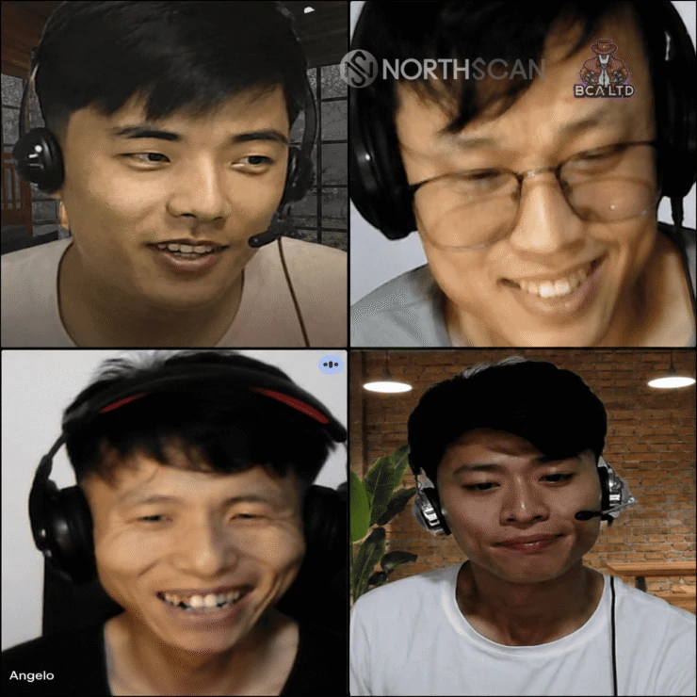
Video interview red flags
Ask them to move the camera
pan around the room - live face-swap tools distort or lag under motion
Request an unprompted screen share
watch lighting and edges around the face for filter artifacts
Ask unscripted follow-up questions
probe stated experience in real time - hesitation and generic answers are signals
Watch mouth-audio sync and lighting
deepfake overlays often drift slightly from voice and ambient light
Hold a government ID up to the live camera
compare the face on file to the face on the call, in real time
Ask basic local knowledge questions
the university they attended, the city they worked in - details anyone who actually lived there would know cold
WATCH: REAL INTERVIEW FOOTAGE
youtube.com/watch?v=vxgf12VoMDM
youtube.com/watch?v=KqhOVIogLGY
Real DPRK IT worker interview calls. Source: Mauro Eldritch & Heiner García - any.run - Lazarus Group IT Workers Investigation, Part Two
youtube.com/watch?v=GNuF0H_K4Tc
14
youtube.com/watch?v=dPAjfHr4kzk
Notes:
Rishi

Slide 15



Facial recognition: the nuclear option
PimEyes
C$40–125/mo
2.1B faces · facial geometry · Bellingcat-approved · incl. takedown help
HYPR SUCCESS STORY
Fake Contractor Hire (2024)
FaceCheck.ID
pay-per-search
Remote engineer claiming to be based in Eastern Europe made it through interviews and reference checks, but not past onboarding.
700M+ faces incl. mugshots · confidence scores 50–100 · fraud focus
WHAT GAVE THEM AWAY
Clearview AI
unavailable
Passport photo didn't match live face scan
50B+ images · 99%+ accuracy · banned for private use · C$140M+ fines
Failed liveness detection
Documents submitted from other location
Went dark after refusing final video check
FREE:Google Images · TinEye · Yandex (best for faces) · Bing Visual
A rehearsed interview can fool a recruiter. It can't fool a live face match against your own ID.
LEGAL: Biometric search is special category data - UK/EU GDPR, PIPEDA, and Québec Law 25 (notify the CAI first).
15
Notes:
Rishi

Slide 16




From interview to investigation
01
02
03
04
Interview passed
Concern raised
Verification review
Mismatch found
Candidate clears the interview process
Internal flag about candidate behaviour
HR re-checks submitted records
Identity discrepancy in screening docs
16
Notes:
Michael

Slide 17
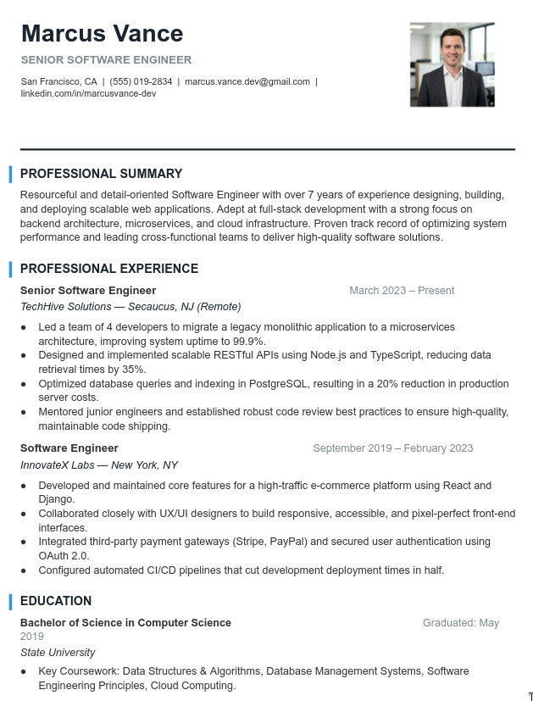


The Resume: catching a ghost with a resume
THE GIVEAWAY
"Marcus Vance"
"David Chen"
Application A
Application B
Same photo. Different name.
Reverse image search exposed a single operator behind multiple personas.
17
Notes:
Michael

Slide 18


What is actually allowed? 🇨🇦
FEDERAL LAW - PIPEDA
PROVINCIAL PRIVACY LAWS
✓ YOU CAN
Canada's main privacy law - collecting personal information, including background checks, needs clear, informed consent.
BC, Alberta & Quebec have their own laws instead of PIPEDA. Quebec also requires disclosure of automated decisions.
Look at professional profiles, like LinkedIn
Confirm credentials with the school or employer that issued them
Run a reverse image search on their photo
Do a background check, once you have clear consent
Ask for a police record check, but only after a conditional job offer
ANTI-DISCRIMINATION LAW
EMPLOYMENT / LABOUR LAW
✕ YOU CANNOT
Federal & provincial Human Rights Codes protect candidates from being screened out for race, religion, or a pardoned record.
Each province's Employment Standards Act sets the ground rules for screening and treating candidates during hiring.
Use data from a hack or leak
Collect personal information without asking first
Request a Vulnerable Sector Check for a job that doesn't need one - that's a criminal offence
Hold a pardoned conviction against someone, where the law protects it
⚠
This slide is for informational purposes only and does not constitute legal advice. Consult qualified counsel for your jurisdiction before acting.
18
Notes:
Michael
Pipeda
At the federal level, PIPEDA governs how we collect personal information, requiring clear and informed consent
Consent, Transparency, Data Minimization
Provincial Privacy Laws
However, keep in mind that British Columbia, Alberta, and Quebec operate under their own provincial privacy laws—with Quebec specifically requiring disclosure if you use automated decision-making tools
Anti Discrimination Law
Employment/Labour Law
guidelines dictate that criminal background checks
Criminal check if required for job, e.g. for police men
Public interest: did financial advisor commit financial fraud?

Slide 19


You've spotted a fake, now what?
REPORT IT
KNOW THE LAW
BEFORE YOU CUT CONTACT
Canadian Anti-Fraud Centre
There's no master list
Save your evidence first
antifraudcentre-centreantifraude.ca
No single public database of known personas exists. Independent researchers and threat intel blogs, like any.run, do publish confirmed identities worth checking
Chat logs, IDs, and payment details, before you end things
FBI, for US-linked cases
tips.fbi.gov or IC3.gov, useful when the case touches US platforms or victims
Don't tip them off early
Hiring them is illegal
They'll simply reappear under a new identity
Paying a North Korean IT worker can break sanctions law even without intent. Ignorance is a weak defence once red flags existed
The platform itself
Share the pattern internally
Flag the account on LinkedIn, Upwork, or the job board so it gets banned
Tell HR and security so they catch the next one
Your legal team
This can trigger sanctions reporting duties, so loop them in early
19
Notes:
Michael

Slide 20
Flip the script: protect yourself
Digital hygiene to reduce your own OSINT exposure
PLATFORM SETTINGS
OPT-OUT PRIORITIES
COMPARTMENTALISE
LinkedIn
UK Electoral Roll
Usernames
Public profile off, hide connections
Opt out of the Open Register
Never reuse handles across platforms
Facebook
Companies House
Email aliasing
Friends-only, limit past posts
Use a registered office; SR01 form
SimpleLogin / AnonAddy per service
192.com
Photo metadata
Twitter / X
Submit a C01 form for removal
Strip EXIF - GPS reveals your home
Protect posts, kill discoverability
Reverse lookup
Quarterly audit
Turn off email + phone search
Run the toolkit on yourself, diff it
Canada411 & brokers
No CA voters roll - brokers still list
20
Notes:
Flip the script: protect yourself.

Slide 21
Pre-employment verification checklist
Practical steps HR & security teams can implement today
1
Reverse-image all photos
5
Username enumeration
Run profile images through Google, TinEye, PimEyes.
Maigret / Sherlock - check account age & genuine activity.
2
Cross-reference locations
6
Verify credentials at source
Resume vs LinkedIn vs shipping - addresses must match.
Contact universities & licensing bodies directly.
3
Analyse resume language
7
Analyse video interviews
Stylometric overlap with other CVs signals templated fraud.
Watch for deepfake artefacts, lighting & audio-sync issues.
4
Check contact details
8
Ship to verified addresses
Shared phone / email / address across applicants is a red flag.
Require ID at pickup - KnowBe4 now ships to UPS stores.
Remember: document your lawful basis first, and run checks only on selected candidates - not every applicant.
21
Notes:
Rishi

Slide 22
Key takeaways
1
Background checks aren't enough
They verify documents, not identity. OSINT catches fabricated personas.
2
Reverse image search is mandatory
Stock & AI photos are the top indicator of identity fraud in remote hiring.
3
Document your lawful basis first
Legitimate interest works but needs an LIA. Never access breach data.
4
Apply OSINT to yourself
Opt out of data brokers, compartmentalise usernames, audit quarterly.
22
Notes:
Rishi

Slide 23
Tools quick reference
CATEGORY
TOOL
NOTES
COST
Username
OSINT Industries
Real-time lookup of accounts linked to emails or phones
Free / C$35–170/mo
Facial
PimEyes
2.1B faces · Bellingcat-approved · includes takedown help
C$40–125/mo
Facial
FaceCheck.ID
700M+ faces incl. mugshots · confidence scores 50–100
Pay-per-use
Email
holehe / Epieos
120+ sites via password reset · doesn't alert target
Free
Email
GHunt
Analyse Google accounts for linked public activity
Free
Phone
PhoneInfoga
Carrier lookup, VoIP detection, porting history
Free
Metadata
ExifTool / FOCA
GPS, device info, author names from 200+ file types
Free
Framework
Maltego / SpiderFoot
Visual link analysis · 200+ data sources
Free / C$1,400+
Web
Wayback Machine
Verify past employment on archived company pages
Free
Breach
Have I Been Pwned
2B+ emails · shows registrations via breach dates
Free
Username
Maigret / Sherlock
3,000+ sites · ~30% false positives - always verify
Free
⚠ CAD shown; vendors bill in USD.
⚠ Pipl: enterprise-only. Clearview: police only.
23
Notes:
Rishi

Slide 24
Q&A
Thank you for listening.
RISHI
MICHAEL
Security Researcher
Security Researcher
SECTOR 2026 · TORONTO, CANADA
Notes:
Rishi

